Slide 1
Instagram user Analytics
BY UTKARSH JAISWAL

Slide 2
Description
As we all know that Instagram is an entirely visual platform and is one of the most used social sites in todays world. Unlike Facebook, which relies on both text and pictures, or twitter which relies on text alone, Instagram’s sole purpose is to enable users to share images or videos with their audience. It is estimated that there are currently over 2.35 billion monthly active Instagram users. Now the question arises that where does all that big data gets stored and how it is managed. To get the clear view about these queries I’ve created a small project “Instagram user analytics”. Based on the user engagement and the data collected the insights needs to be carried out and presented to the product team. The project ill answer to the important questions like:
Rewarding the most loyal user
Inactive user engagement
Contest Winner declaration
Hashtag research
Ad campaign Launch
User Engagement
Bots & fake accounts

Slide 3

Tech-Stack Used
For gaining the better visibility of the database I’ve used SQL(Ver 8.0.34), which was specified to me in the program and downloaded it from the link provided. After that I’ve downloaded the SQL Workbench(Ver 8.0.34) which provides a visual console to easily create the MySQL environment.

Slide 4
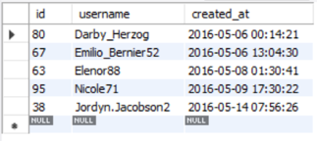
Task 1: Rewarding the most loyal user
People who have been using the platform for the longest time. Our task is to find the 5 oldest users of the Instagram from the database provided.
SQL Query
Result
SELECT *
FROM users
ORDER BY created_at
LIMIT 5;

Slide 5
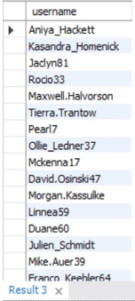
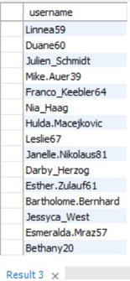
Task 2: Inactive user engagement
By sending them promotional emails to post their 1st photo. Our task is to find the users who have never posted a single photo on Instagram.
SQL Query
Result
SELECT username
FROM users
LEFT JOIN photos
ON users.id = photos.user_id
WHERE photos.id IS NULL;

Slide 6
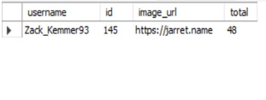
Task 3: Contest winner declaration
The team started a contest and the user who gets the most likes on a single photo will win the contest now they wish to declare the winner.
Our task is to identify the winner of the contest and provide the details to the team.
SQL Query
Result
SELECT
username,
photos.id,
photos.image_url,
COUNT(*) AS total
FROM photos
INNER JOIN likes
ON likes.photo_id = photod.id
INNER JOIN users
ON photos.user_id = users.id
GROUP BY photos.id
ORDER BY total DESC
LIMIT 1;

Slide 7
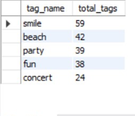
Task 4: Hashtag research
A partner brand wants to know, which hashtags to use in the post to reach the most people on the platform.
Our task is to identify and suggest the top 5 most commonly used hashtags on the platform.
SQL Query
Result
SELECT tags.tag_name, COUNT(*) AS total_tags
FROM photo_tags
JOIN tags
ON photo_tags.tag_id = tags.id
GROUP BY tags.id
ORDER BY total_tags DESC
LIMIT 5;

Slide 8
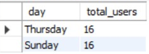
Task 5: Ad campaign launch
The team wants to know, which day would be the best day to launch Ads.
Our task is to identify what day of the week do the most users register on? Provide insights on when to schedule an ad campaign.
SQL Query
Result
SELECT DAYNAME(created_at) AS day,
COUNT(*) AS total_users
FROM users
GROUP BY day
ORDER BY total_users DESC
LIMIT 2;

Slide 9
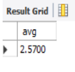
Task 6: User engagement
Are users still active and post on Instagram or they are making fewer posts.
Our task is to provide how many times does average user posts on Instagram. Also, provide the total number of photos on Instagram/Total number of users.
SQL Query
Result
SELECT (
SELECT COUNT(*)
FROM photos)/(SELECT COUNT(*) FROM users
) AS avg;

Slide 10
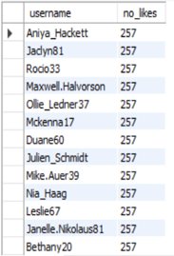
Task 7: Bots & Fake accounts
The investors want to know if the platform is crowded with fake and dummy accounts.
Our task is to provide data on users(bots) who have liked every single photo on the site(since any normal user would not be able to do this).
SQL Query
Result
SELECT username,
COUNT(*) AS no_likes
FROM users
INNER JOIN likes
ON users.id = likes.user_id
GROUP BY likes.user_id
HAVING no_likes = (SELECT COUNT(*) FROM photos);

Slide 11

OVERALL RESULT
While completing this project I got to learn about so many concepts of SQL fundamentals that’ve helped me a lot in solving the most complex problems irrespective of how large the database is. I gained a knowledge of using SQL and MySQL workbench which will help me in future a lot. I’ve completed all the tasks assigned to me

Slide 12
THANK YOU!

